Slide 1

Using REDCap for:
Presented by
Dr. Farah Shahi MBChB BMedSci(hons) DTM&H MRCP(UK)
Clinical Research Fellow
Clinical Infection Research Group, IICD
@dresmerelda
Darton, Baker et al
The project is funded by a grant from the Bill & Melinda Gates Foundation

Slide 2






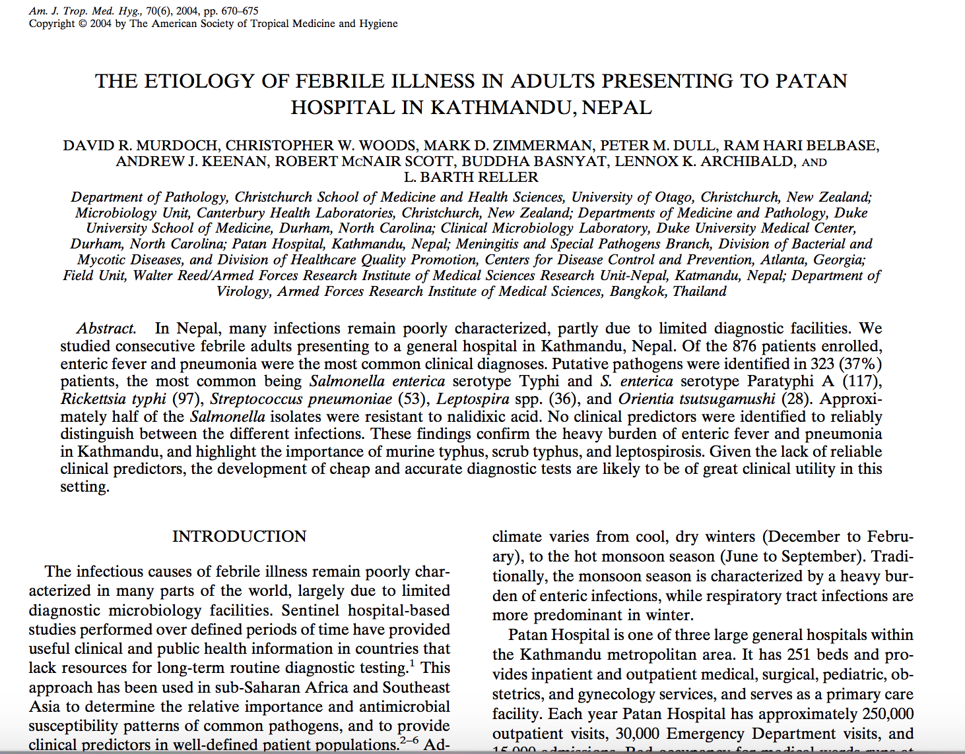
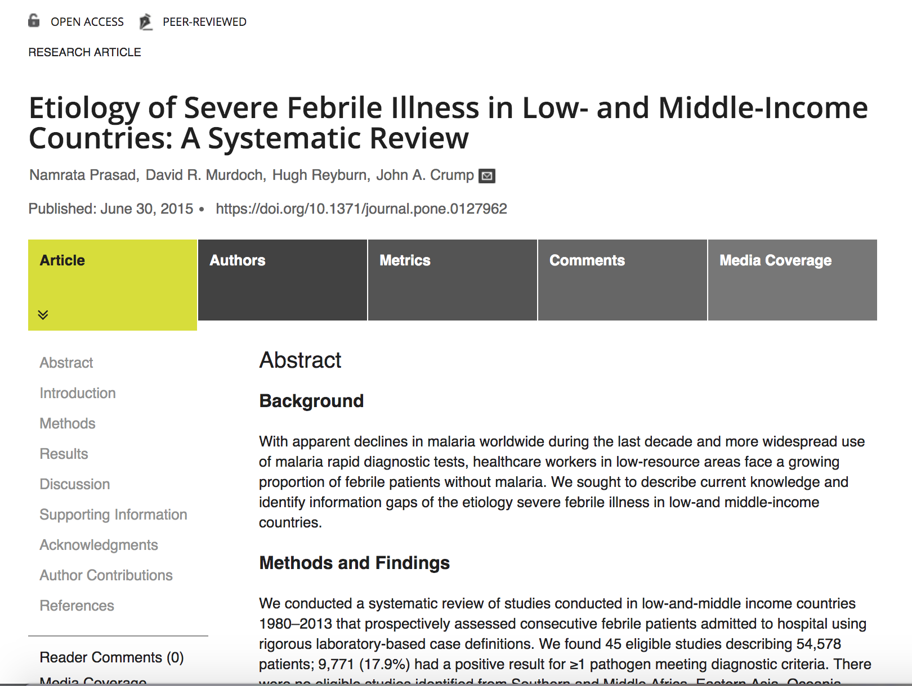

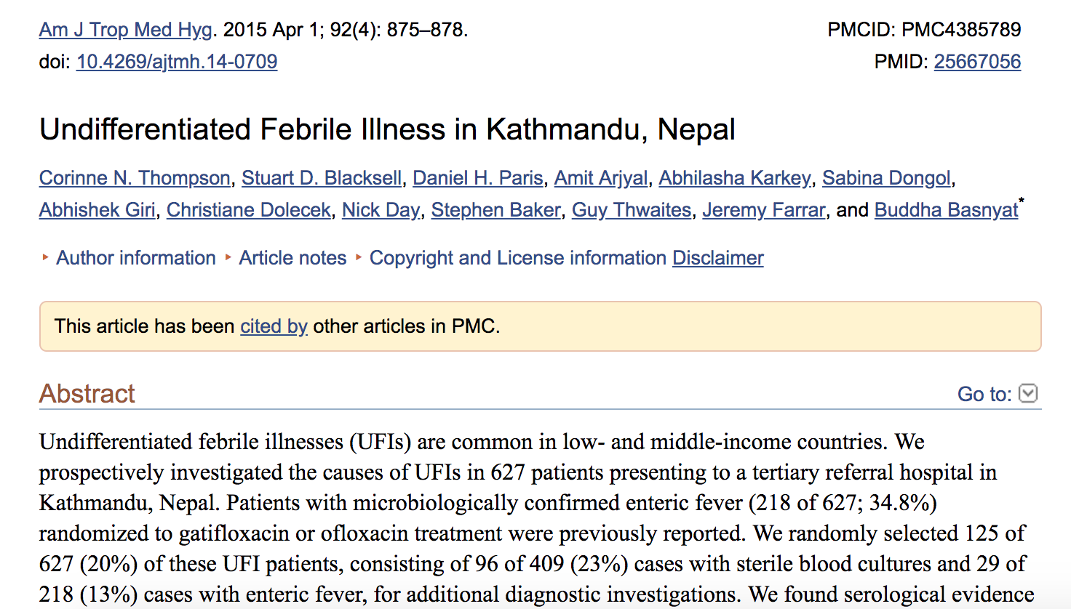


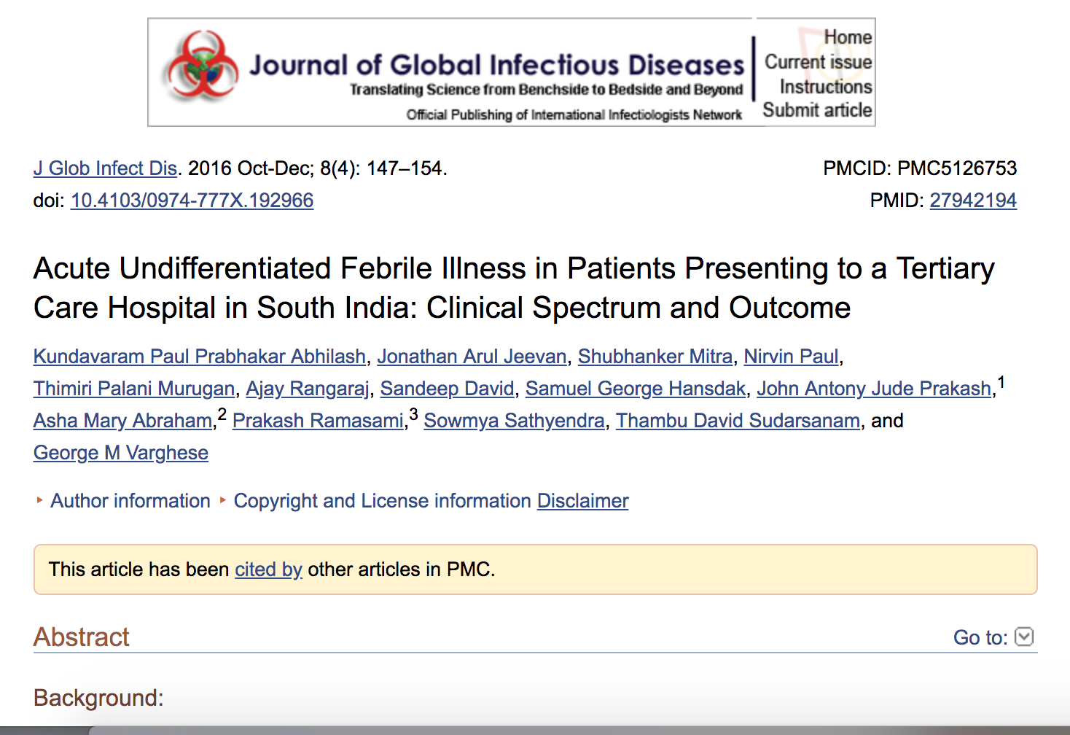
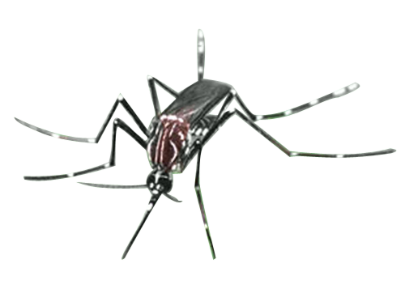
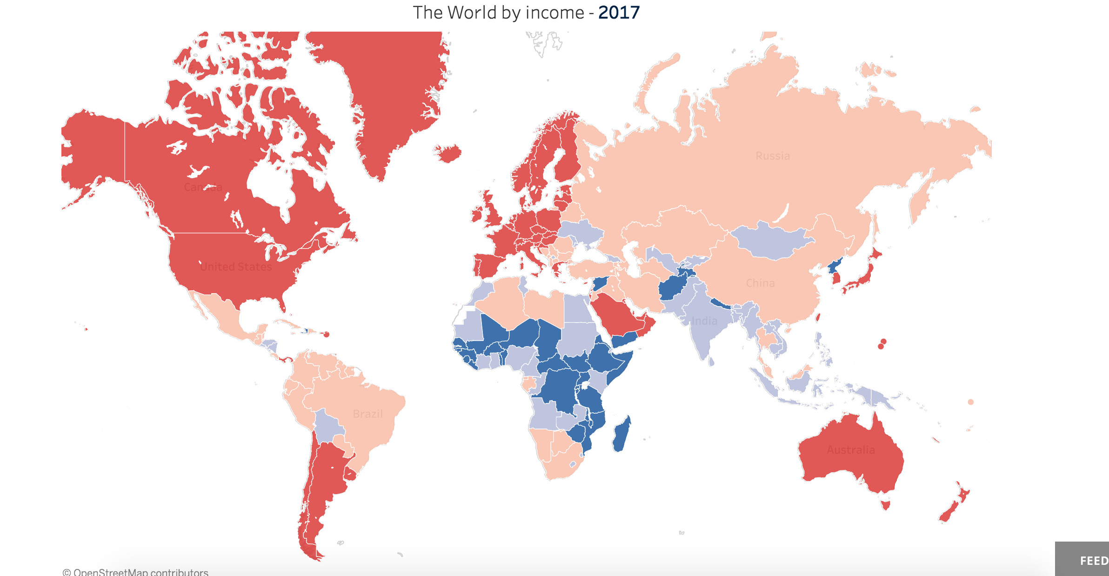

Background
AUFI
Clinical Challenge

Slide 3

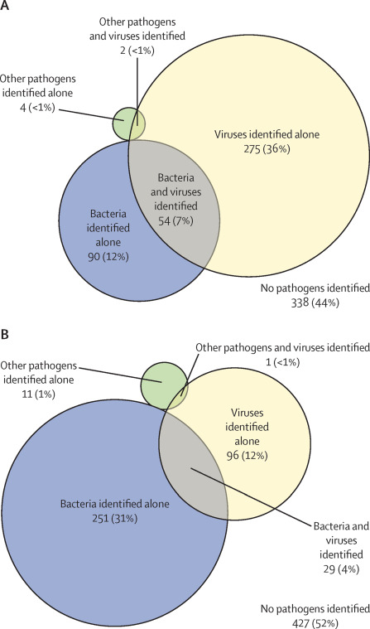




Diagnostics
Southeast Asia Infectious Disease Clinical Research Network. Causes and outcomes of sepsis in southeast Asia: a multinational multicentre cross-sectional study. 2017. Lancet. Glob Health. 5(2): E157-E167.
Paediatric cases
Phenotypic tests
Serological tests
Host biomarkers
Molecular Methods
Adult cases

Slide 4
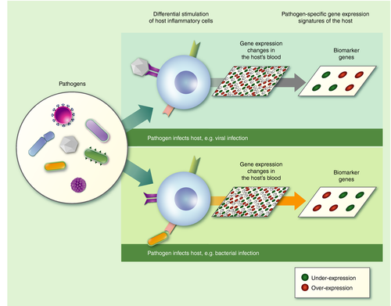
Gliddon et al. Genome‐wide host RNA signatures of infectious diseases: discovery and clinical translation. 2018. Immunology. 153(2): 171-178
CC BY-NC 4.0

Slide 5
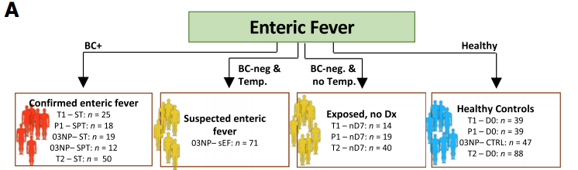

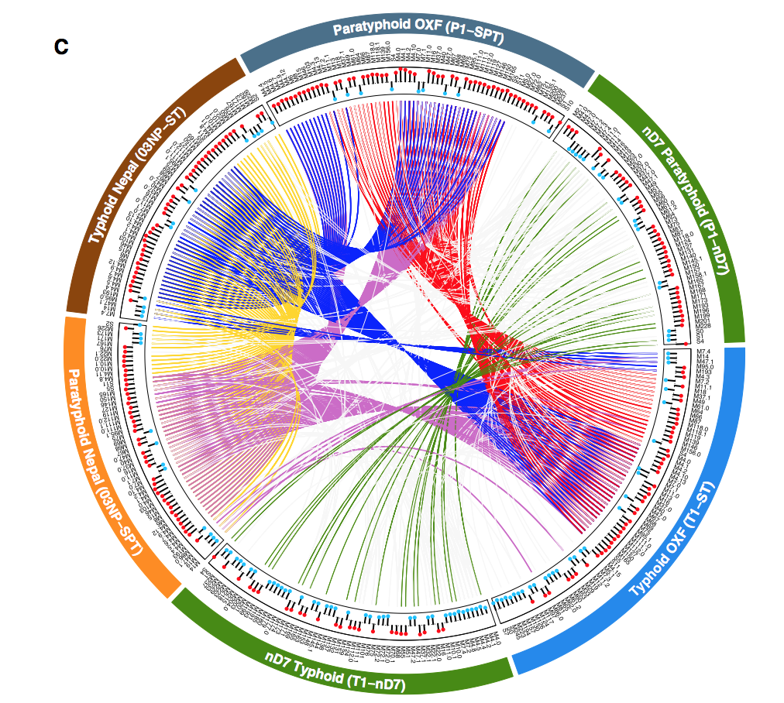
Background
Blohmke et al. Diagnostic host gene for distinguishing enteric fever from other febrile diseases. 2019. EMBO Molecular Medicine. e10431
CC BY 4.0

Slide 6
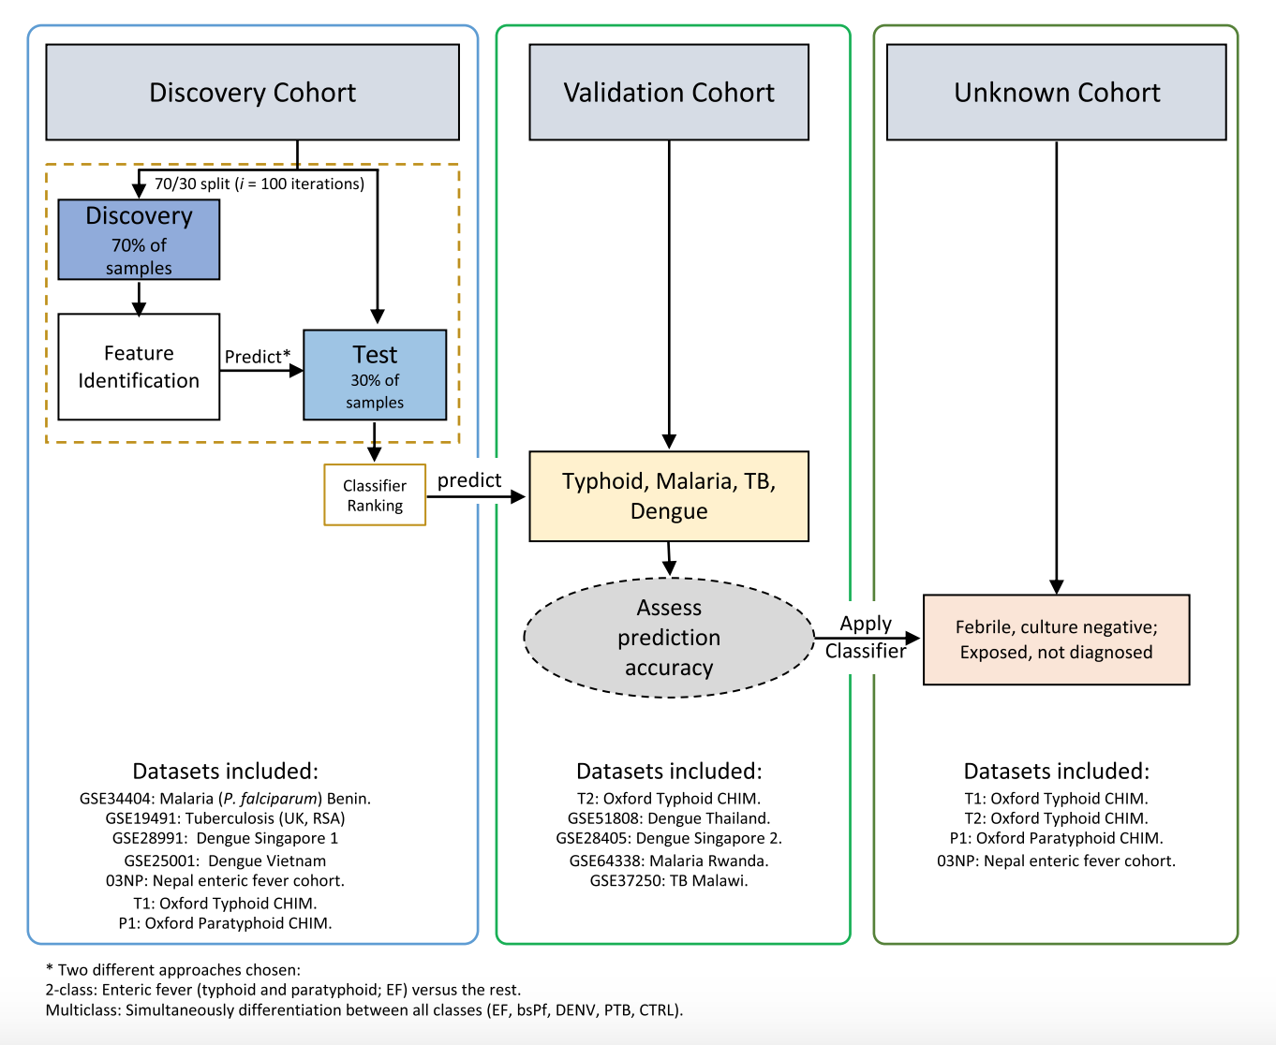
Background
Blohmke et al. Diagnostic host gene for distinguishing enteric fever from other febrile diseases. 2019. EMBO Molecular Medicine. e10431
CC BY 4.0

Slide 7
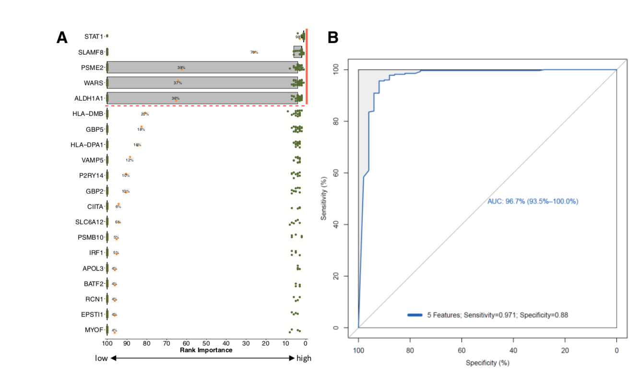
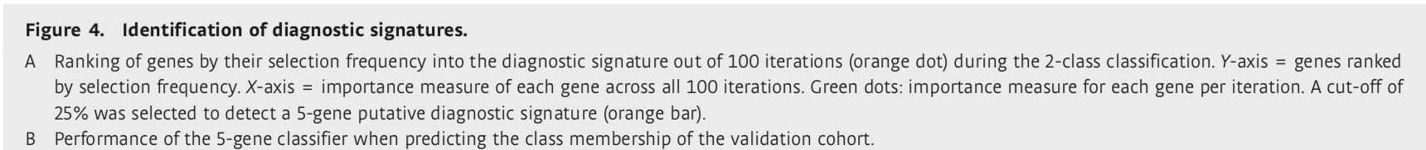
Background
Blohmke et al. Diagnostic host gene for distinguishing enteric fever from other febrile diseases. 2019. EMBO Molecular Medicine. e10431
CC BY 4.0

Slide 8
Aims & Objectives
 | Objectives | Outcome Measures
Primary | Evaluate host gene transcription signatures Enteric fever Adults with AUFI Endemic settings | Diagnostic score 5-gene transcription signature (STAT1, SLAMF8, PSME2, WARS, ALDH1A1) Enteric fever
Secondary | Determine the probable causes of AUFI in these cohorts | Relative disease prevalence at each site
Secondary | Assess relationship: routinely collected biomarkers inc CRP level of molecular perturbation | Clinical and laboratory metadata diagnostic test RNA-seq data analysis
Exploratory | Evaluate gene transcription responses Individual causes of fever Additional publicly available datasets | Formation of gene expression datasets Identification of signatures Validation by qPCR (or alternative)
Exploratory | Causes of AUFI in children Evaluate gene transcription responses | Relative disease prevalence at each site

Slide 9

Protocol
Study sites
CMC, Vellore, South India
Other site in South East Asia ?Indonesia
(Additional data from other large trials in Malawi, Zimbabwe and challenge studies)
Participants (at each site)
600 febrile adults
200 febrile children
200 adult controls

Slide 10

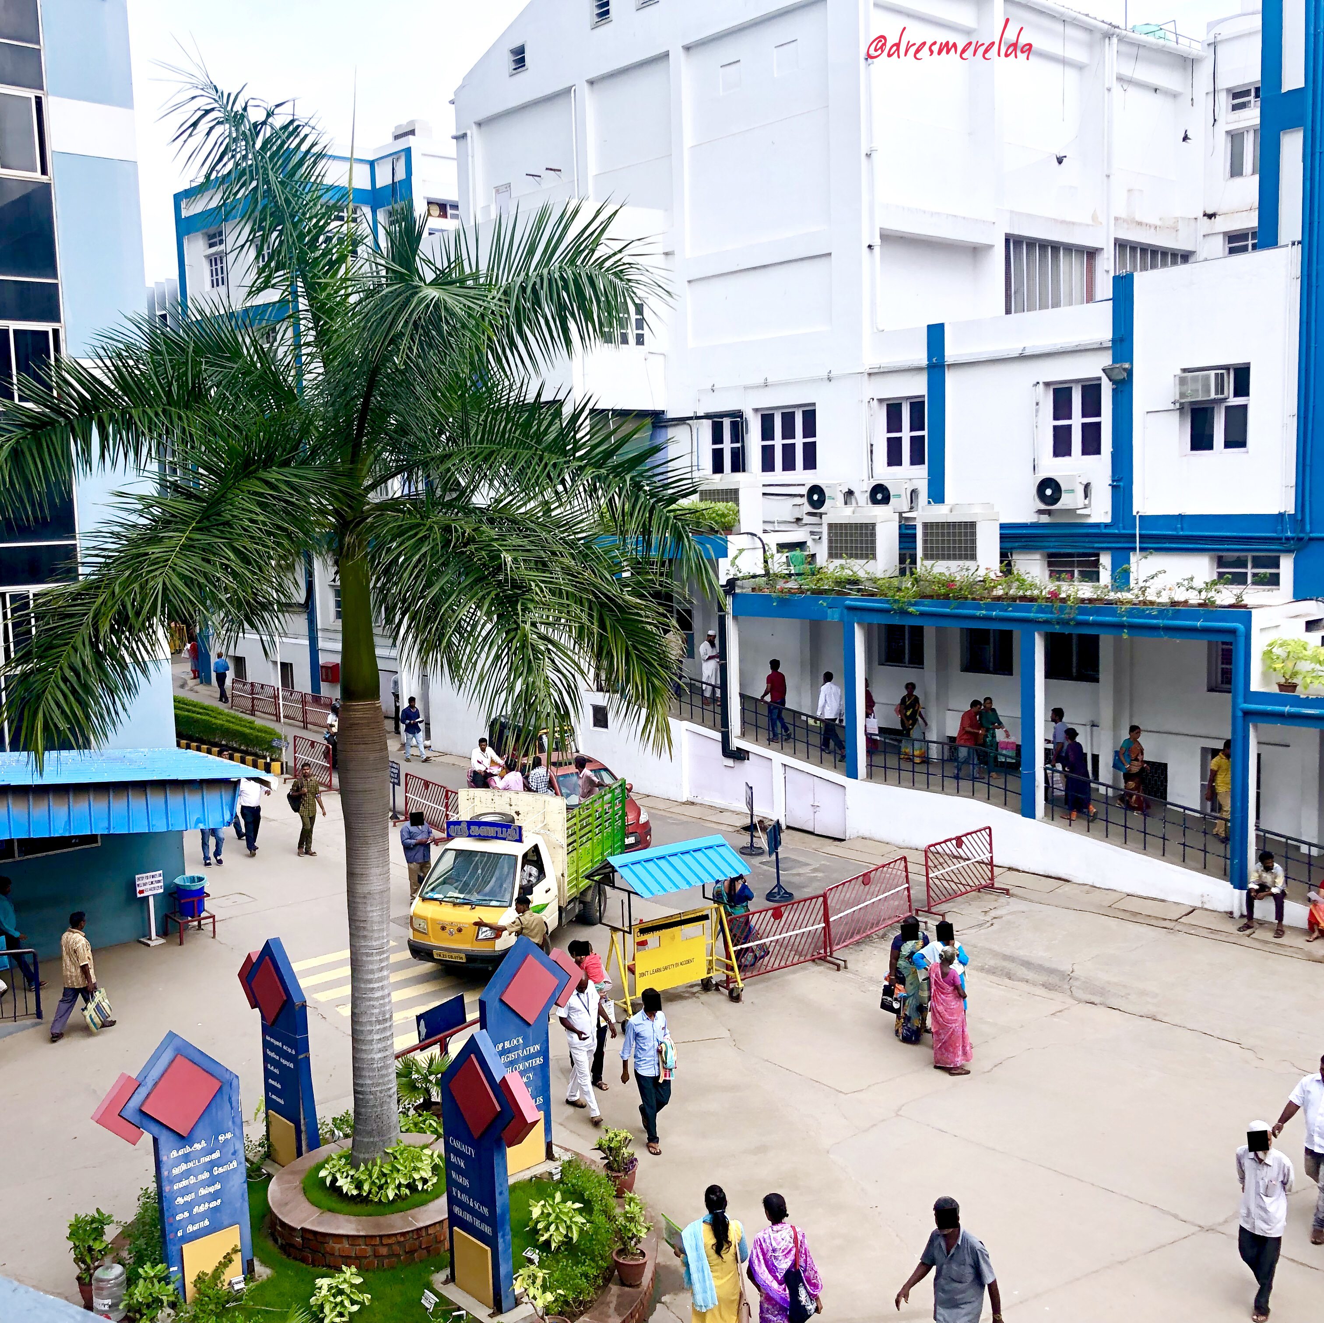
CMC, Vellore, India

Slide 11


Metadata
Samples

Slide 12
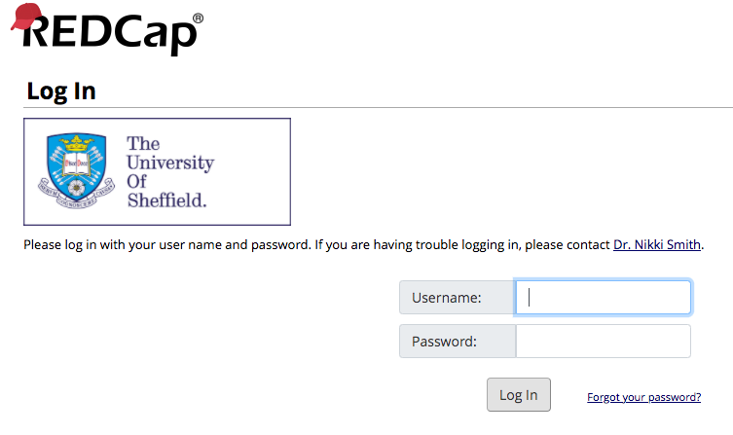
Metadata collection
Sample monitoring

Slide 13
Some user issues:
Did require our own license
Does require regular updates
Is partly reliant on (currently ‘separate’) University updates to virtual machines
Paper forms require rethinking…

Slide 14
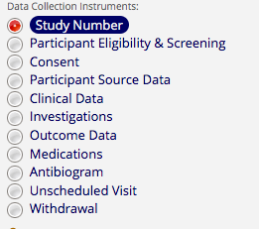
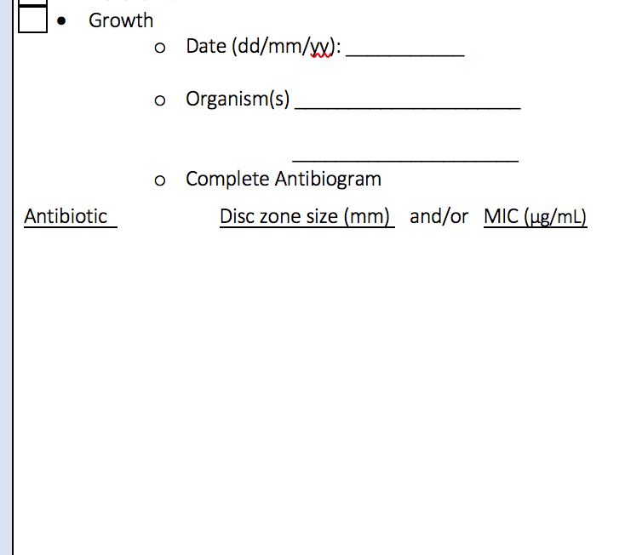
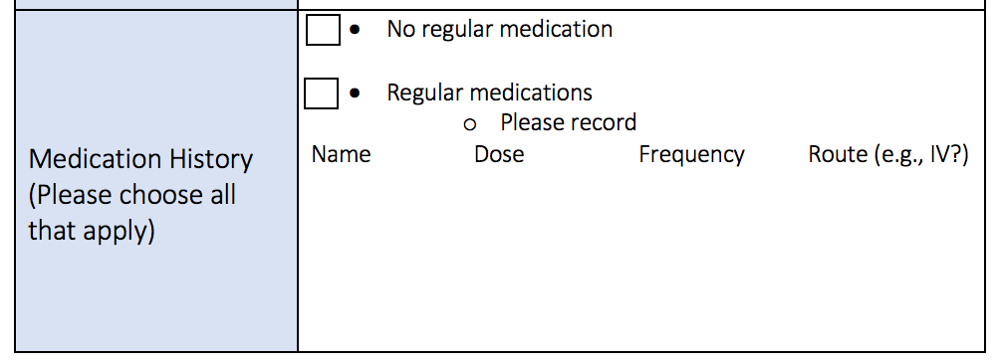
REDCap ‘Con’
Sometimes requires a change in the format of the forms, where paper would be ‘easier’ or a matrix would preferably have a less rigid structure; matrices can’t be copied…

Slide 15
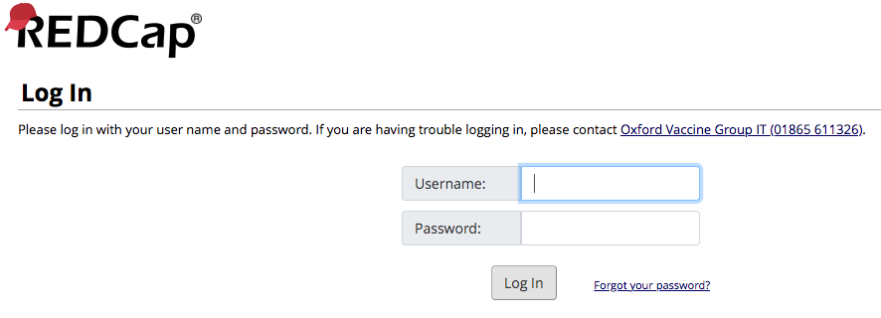
Current ‘sticking’ point
Removing the firewall- working closely with IT who are very helpful and suggesting other solutions (eg, IP-specific access), but this feels like an unfortunate barrier within our University at present

Slide 16
So why did we choose REDCap?
Preferred by our study partners
Large dataset
‘Real-time’ monitoring from afar- particularly useful in a pandemic now!
Reduces the risk of transcribing errors from paper documents
Easy to edit and set up before going ‘live’ (and some tweaks still possible once ‘live’)
Easy back-up
Easy exportation for analysis

Slide 17
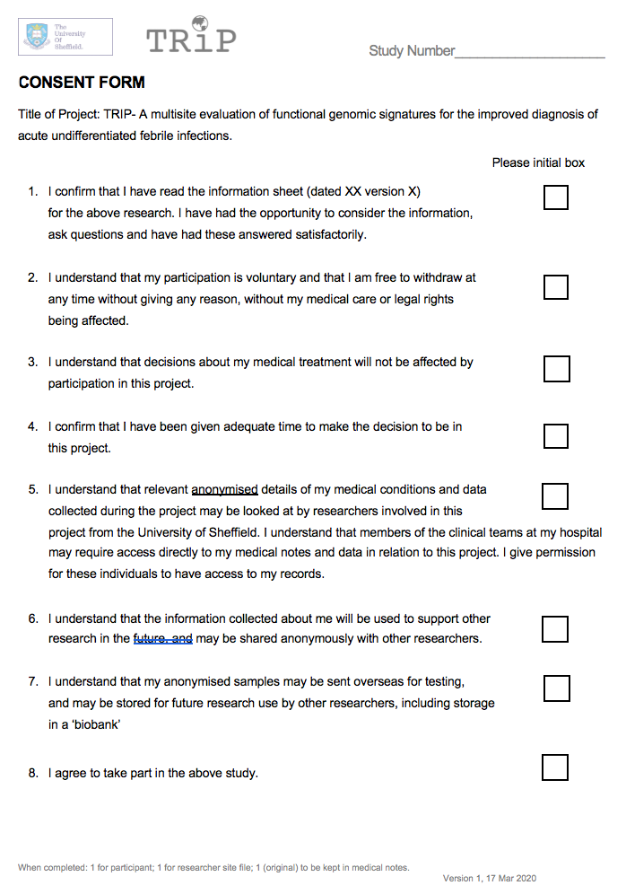
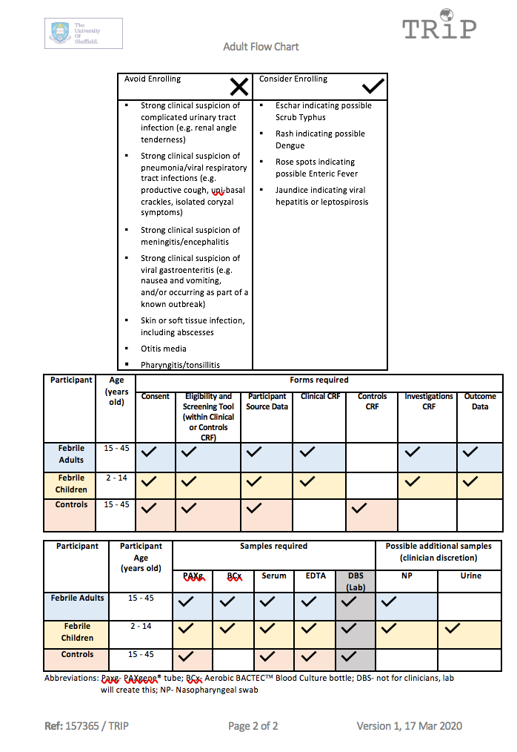
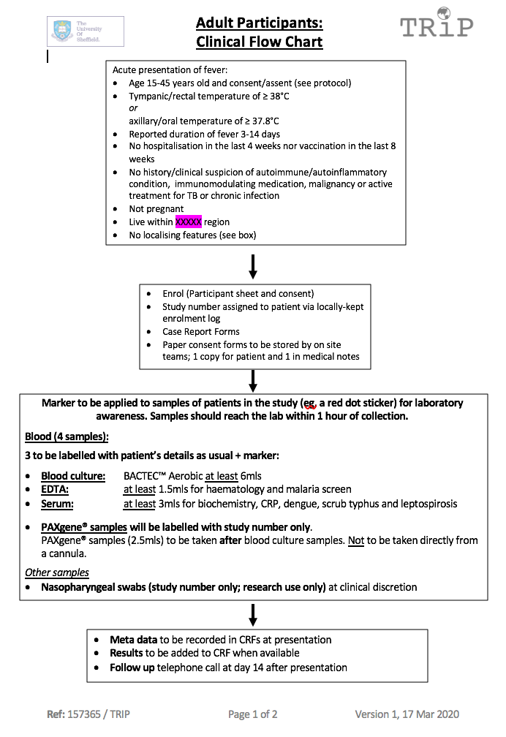
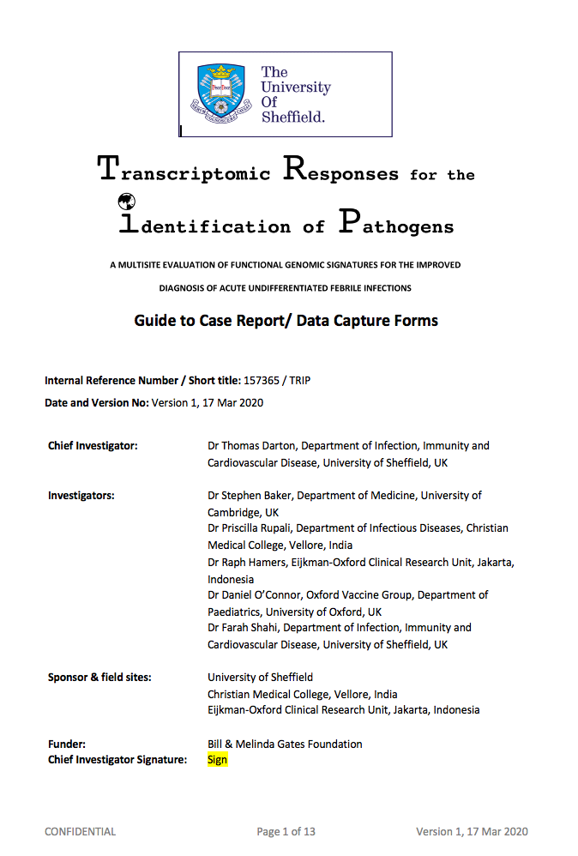
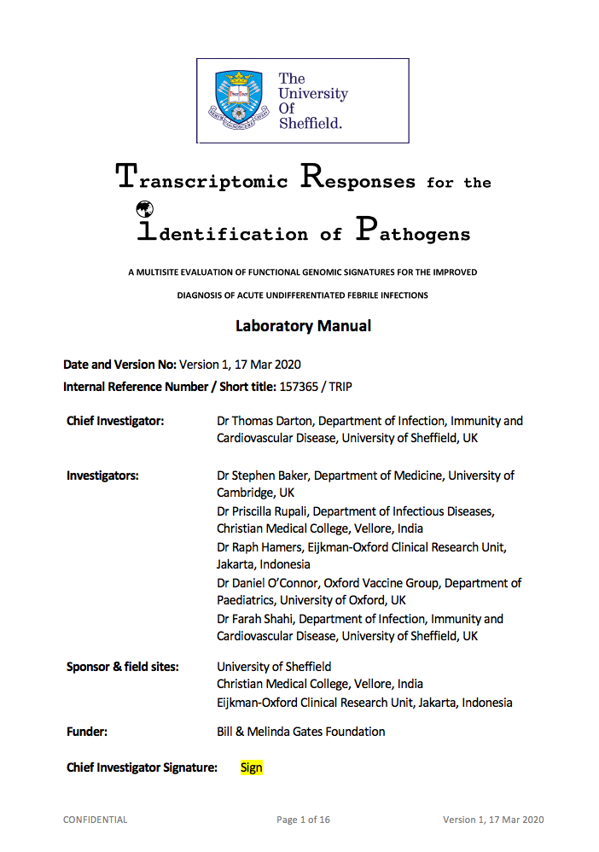
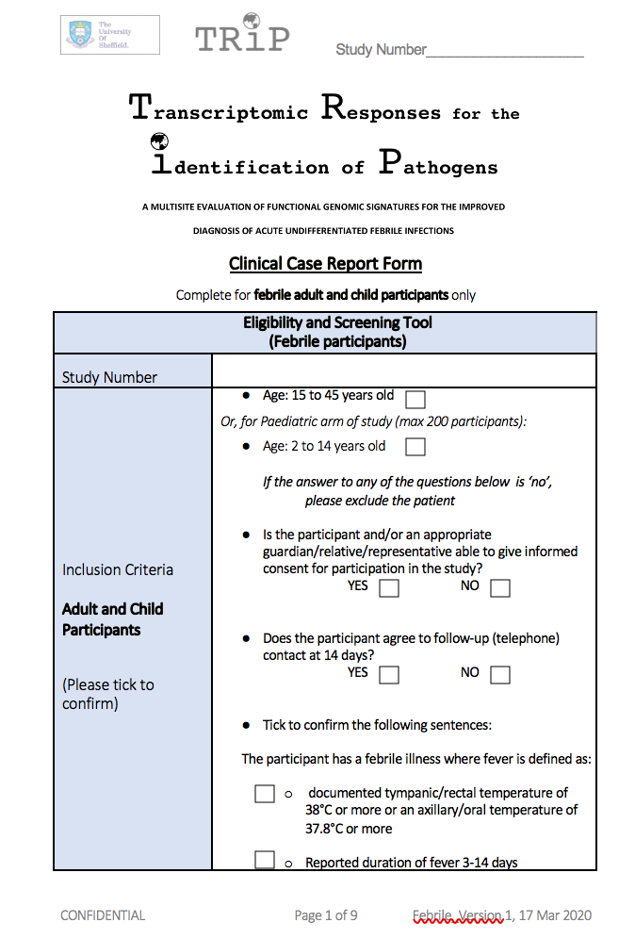
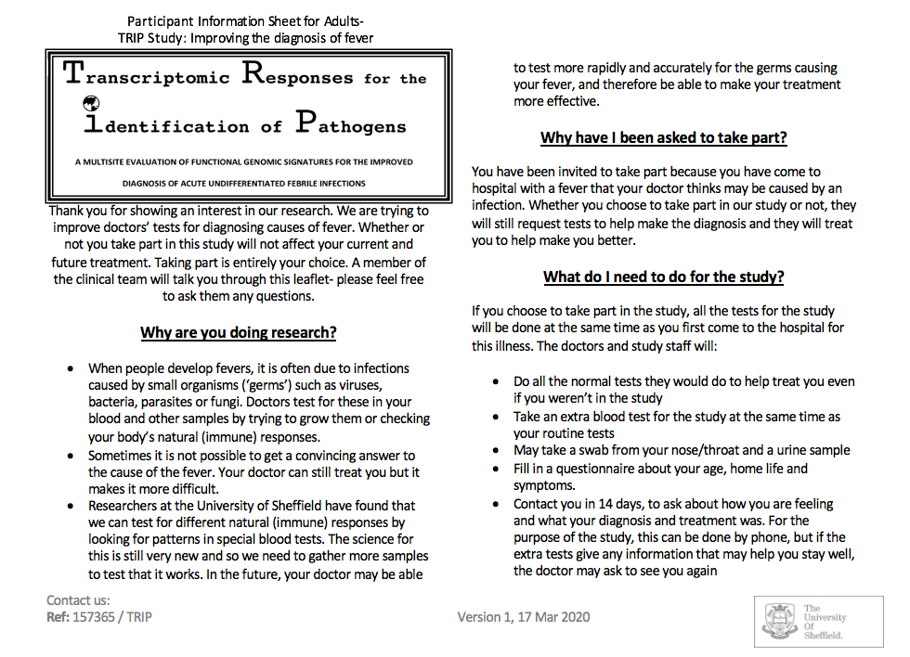
Document Creation -more than just the protocol

Slide 18
Document Creation -more than just the protocol

Slide 19
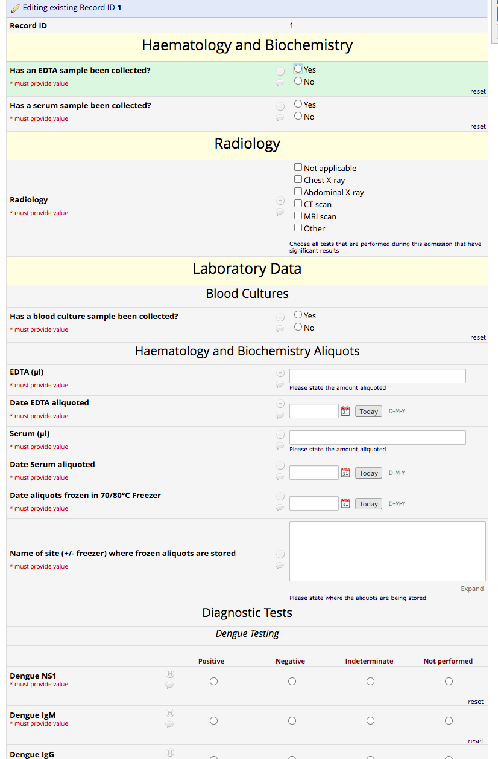
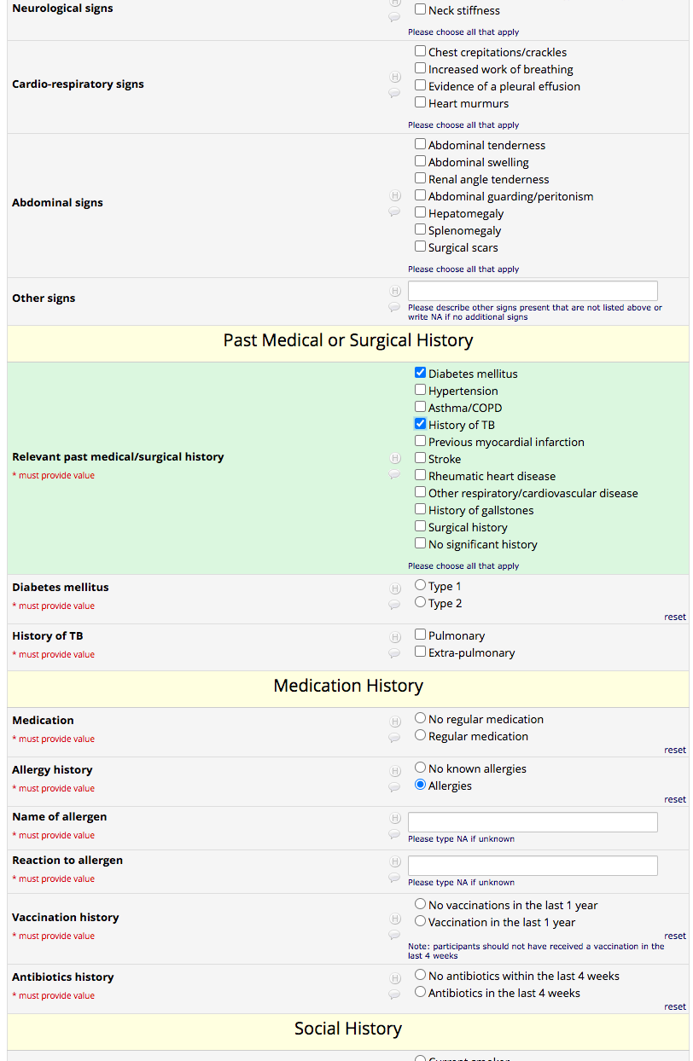
Favourite REDCap ‘pro’
Branching Logic options
“Correct” paperwork for each participant type
Requires answers where paperwork might be left blank
Encourages accurate sample/data collection

Slide 20
In Summary
REDCap is something of a blessing!

Slide 21
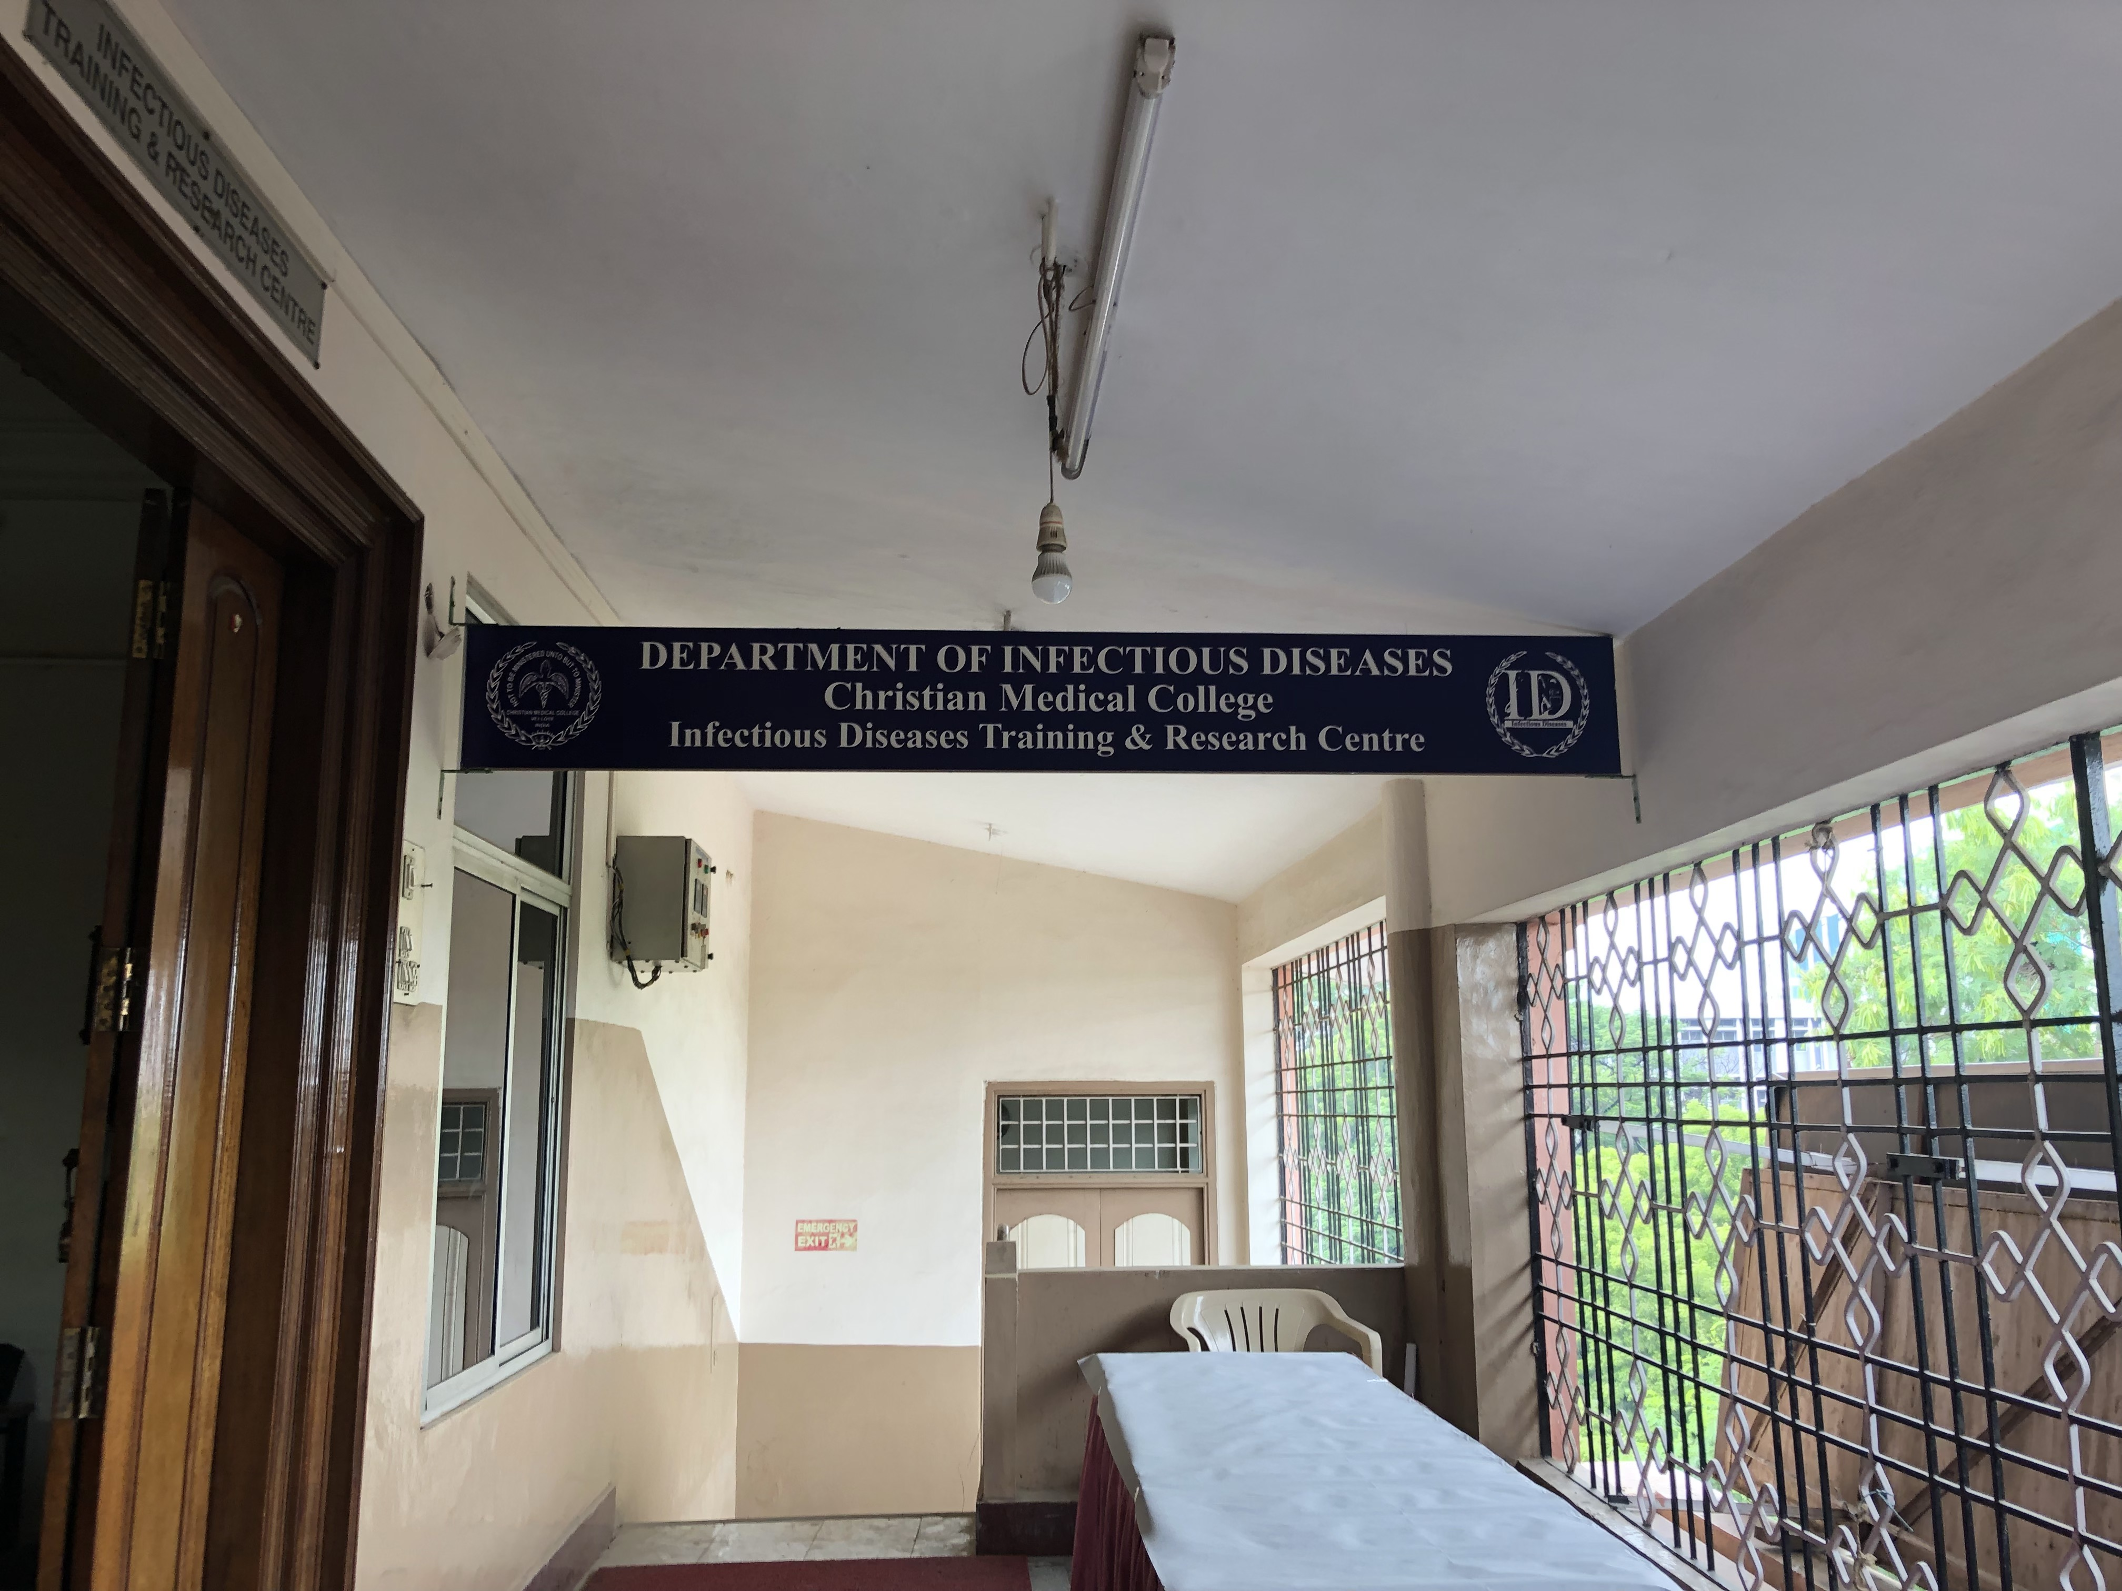
Thank you for listening Questions?
Supervisors:
Project Manager:
Dr Thomas Darton
Dr Nikki Smith
Colleague:
Dr Thushan de Silva
Dr Pete Johnston
Collaborators:
Funders:
Bill & Melinda Gates Foundation
Dr Priscilla Rupali and the team at CMC, Vellore

